Slide 2
Overview of Tutorial
Chapters 5 and 6 of Study Guide
Chapter 5 : Introduction to Graph Theory
Chapter 6 : Digraphs and Relations
Subject Matter for Tutorial
Selected end of chapter revision questions
Selected past paper questions
Also
Questions and Queries

Slide 3
Chapter 5: Graph Theory
Key Terminology
Vertex / Vertices
Edges
Neighbours
Adjacency

Slide 4
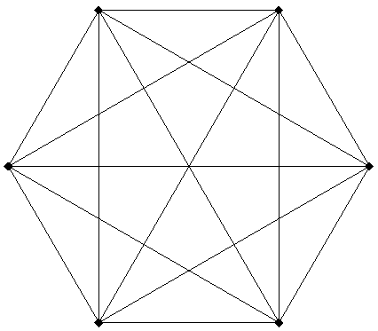
Complete Graphs

Slide 5
Complete Graphs
K₁, K₂, K₃,K₄ (See figure 5.5 page 73 Volume 1)
Number of edges in a K_{n} graph

Slide 6
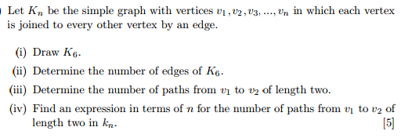
Examination Standard Question

Slide 7
Adjacency List
Write out the Adjacency List for the following matrix.
Also Write down the Degree Sequence

Slide 8
Paths

Slide 9
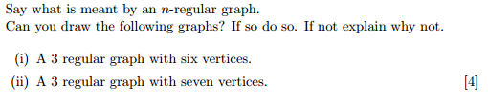
n-regular graphs

Slide 10
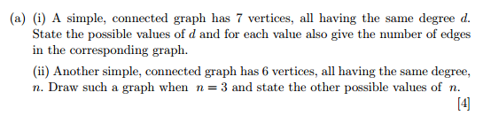
Degrees of a Vertex

Slide 11
Degrees of a Vertex

Slide 13
Venn Diagram / Blank Page

Slide 14
Venn Diagram / Blank Page

Slide 15
Venn Diagram / Blank Page

Slide 16
Venn Diagram / Blank Page

Slide 17
Venn Diagram / Blank Page

Slide 18
Venn Diagram / Blank Page

Slide 19
Venn Diagram / Blank Page

Slide 20
Venn Diagram / Blank Page

Slide 21
Venn Diagram / Blank Page

Slide 22
Venn Diagram / Blank Page

Slide 23
Venn Diagram / Blank Page

Slide 24
Venn Diagram / Blank Page

Slide 26
Venn Diagram / Blank Page

Slide 27
Venn Diagram / Blank Page

Slide 28
Venn Diagram / Blank Page

Slide 29
Venn Diagram / Blank Page

Slide 30
Venn Diagram / Blank Page

Slide 31
Venn Diagram / Blank Page

Slide 32
Venn Diagram / Blank Page

Slide 33
Venn Diagram / Blank Page

Slide 34
Venn Diagram / Blank Page

Slide 35
Venn Diagram / Blank Page

Slide 36
Venn Diagram / Blank Page

Slide 37
Venn Diagram / Blank Page

